Slide 1
AGI Safety Fundamentals
Project by Axel Ahlqvist

Slide 2
Description of project
The idea was to implement an RL-agent in a simple environment since that would give me some RL experience which a lot of current practical AGI-safety work deals with.
I found the Patrick Loeber’s guide on his youtube channel “Python engineer” and followed it to create an RL-agent playing the classic game snake.
After I got it running, I tried to modify a few things to increase my understanding of the code and develop some intuition with RL training.
The thing I changed that had the most relevance to AGI-safety was to modify the reward function. I have read that a common outer alignment problem is that unless you explicitly punish the agent for stalling they tend to stall as to avoid loosing. I tried to remove this punishment to see what effects it would have on the behaviour. Removing the punishment turned out to not noticeably change the behaviour implying that the reward function could be simplified without degrading performance.

Slide 3
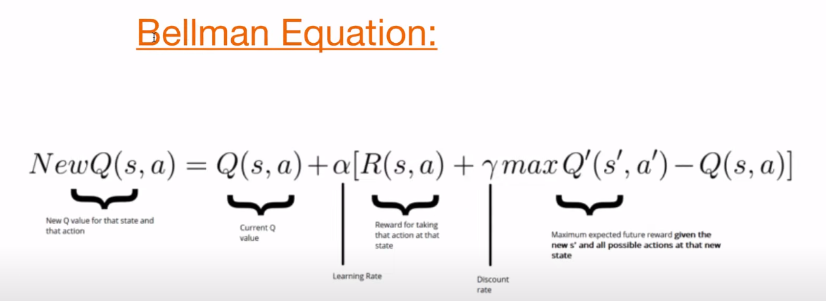
Describing the code
The model is a fully connected network with 3 layers. 11 Input nodes, 256 nodes in the hidden layer and 3 nodes in the output layer.
The 11 binary input nodes contain the following information. If there are obstacles one step away in any of the agents possible directions (3), the agents direction (4) and the cardinal direction of food (4).
The 3 binary outputs are the agents actions and decides if the agents should turn right, turn left or stay on its course.
The agent gets rewards for eating food and punishment for dying.
The learning is instant and not cumulative. After every frame it trains on the mapping between the state, the action and the reward by utilising the Bellman Equation seen above. After every game it trains on up to 1000 samples of the game.
There is a variable that determines the agents explore/exploit policy making the agent less open to trying actions it does not believe to be optimal. The more games the agent have played the more exploitative and less explorative it becomes.
There is a parameter gamma which is the discount rate, it determines how much the expected future reward affects the tuning.

Slide 4
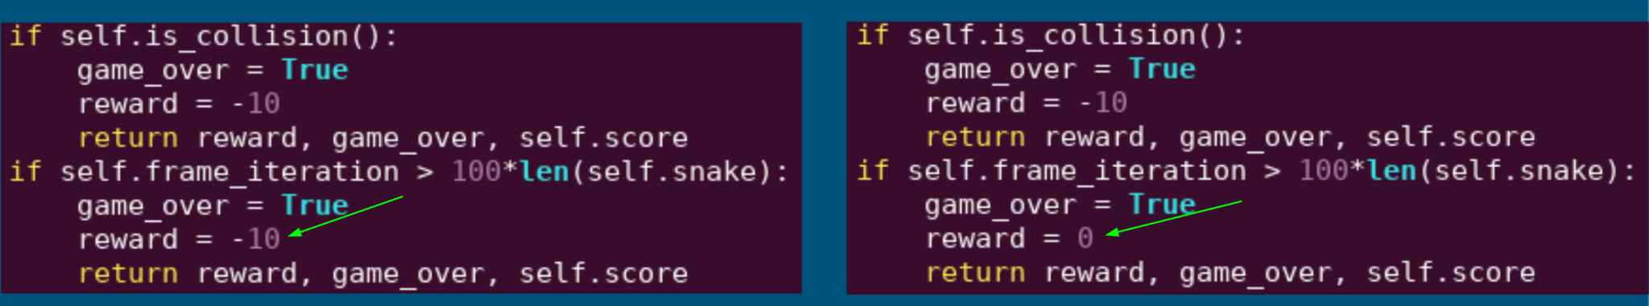
Method
I trained two agents where the goal functions where different. In run 1 the agent received as much punishment for stalling as if it had collided with a wall. In run 2 the agent received no punishment for stalling. For each run I waited until the performance converged. This took approximately 150 games for both runs. Stalling is defined as the agent spending more frames (the snake moves one box a frame) than a 100 times its length before colliding or finding food.
Run 1 Run 2

Slide 5

Example of run 1

Slide 6
Example of almost stalling from run 2
(Did not manage to record a real stalling but the behaviour in the beginning of this video is what it looks like)

Slide 7
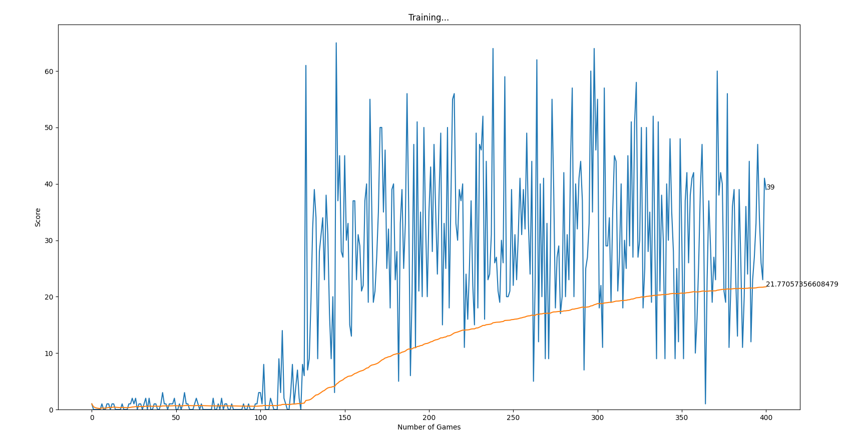
Run 1
After 150 games the agent converged to getting about 29 points per game. After 400 games the performance was still the same. After converging it always lost due to shutting itself in. I once observed that it shut itself in, even though planning one step ahead would have been enough to realise the mistake.
Score while training. The blue line is the actual scores while the orange line is the average of all the games so far.

Slide 8
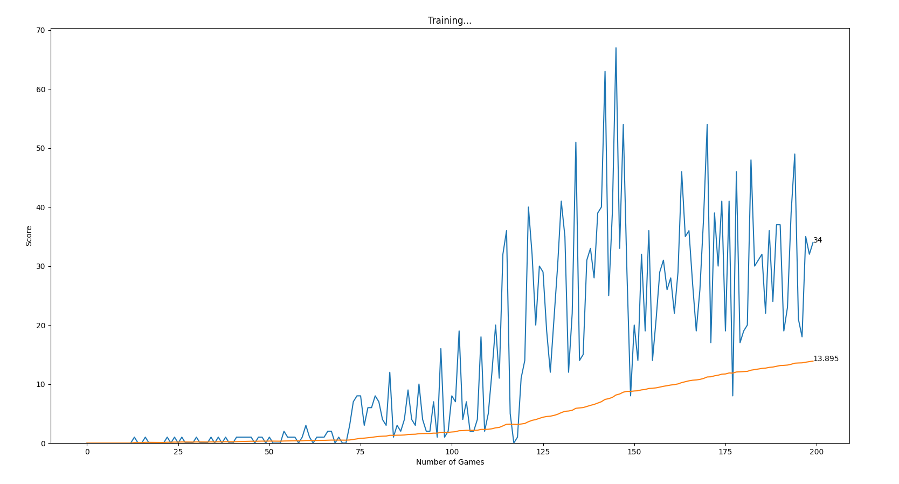
Run 2
After converging the agent did not die from stalling and its behaviour became indistinguishable from run 1.

Slide 9
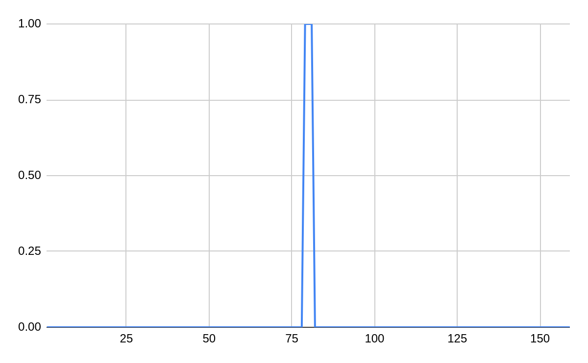
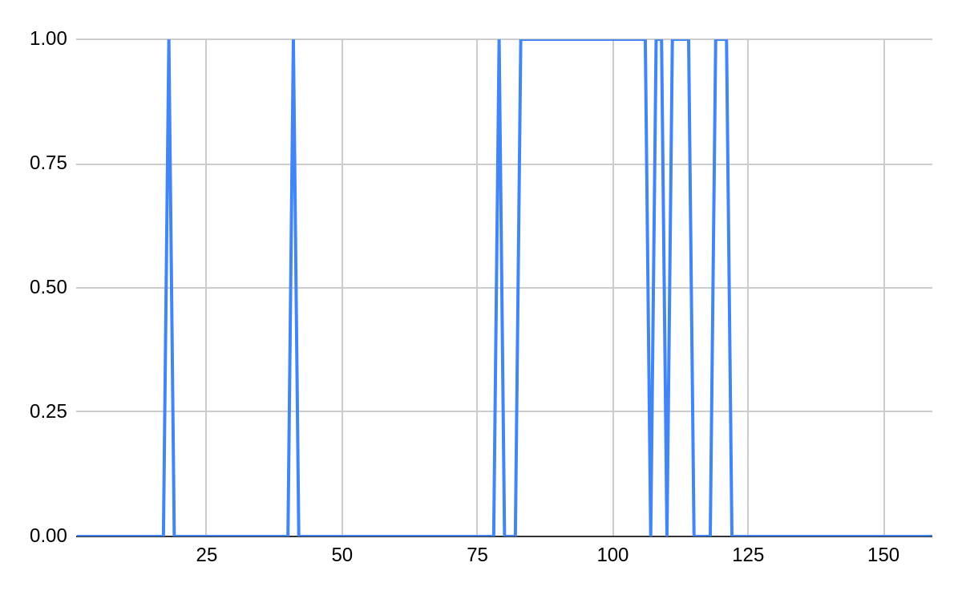
Stalling comparisons
While there is a noticeable difference in frequency of stalling, the agent easily learns to avoid this behaviour in both runs.
Run 1 Run 2
The y-axis represent whether the game ended with the snake stalling, the x-axis represent the game. There were no instances of stalling after the first 125 games in either run.

Slide 10
Problems
A problem was that it was hard to check performance since there is so much randomness in how high score the agent received. I took the average over 15 games but this turned out to still produce too much variance.
The stalling is also based on very random processes so those results might also be questionable.

Slide 11
Discussion
I see no harm in this example in adding complexity to the reward function that does nothing useful. Still we might get to at point where our reward functions are very complicated and where it is important to simplify them for humans to feasible deal with them. In this context, punishing stalling, seems to not be necessary. Though you still need something that resets the game, when it stalls.
It is also of interest that this context is a very simple on. The input the agents are given biases it to learn the simple strategy of moving in one of the directions towards the food and to always steer away from obstacles that are next to it. In more difficult environments the results would probably look very different.

Slide 12
Conclusions
The punishment for stalling probably made the learning slightly faster but even without it, the agent quickly converged to not stalling. It might be that the important thing about dealing with stalling is making sure that the agent is reseted every once in a while. While stalling, the agent doesn’t learn anything so it needs some way to get out of that situation. The reason it doesn’t much like to stall might be that this is an environment where it is relatively easy to do actions that lead to positive reward. In a super mario level, the vast majority of random sequences of moves will lead to defeat with almost no progress. But in snake I believe that a bigger proportion of the possible sequences of actions lead to progress.

